Slide 1
Web Scraping 101
By Ayden Koh
Ayden.koh@digitas.com

Slide 2
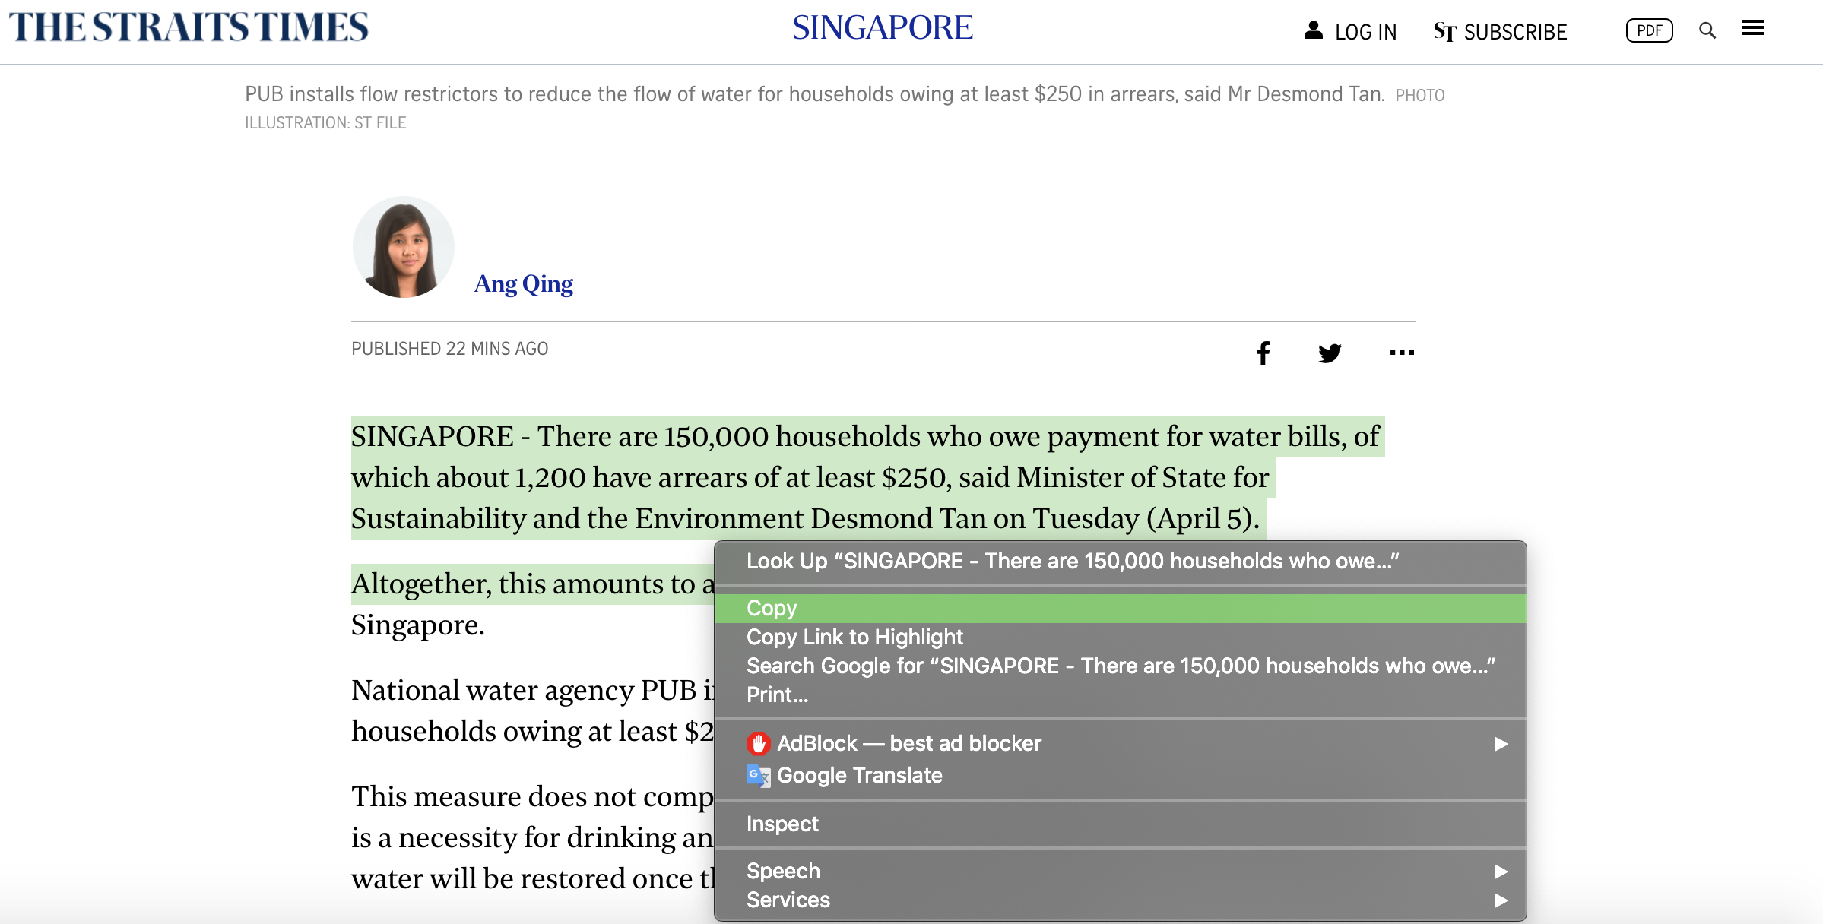
What is Web Scraping?

Slide 3
What is Web Scraping?
Web scraping is the process of collecting structured web data in an automated fashion. It’s also called web data extraction.
Some of the main use cases of web scraping include:
price monitoring
price intelligence
news monitoring
lead generation
market research among many others.
In general, web data extraction is used by people and businesses who want to make use of the vast amount of publicly available web data to make smarter decisions.

Slide 4
The Web Data Scraping Process
Identify the target website
Collect URLs of the pages where you want to extract data from
Make a request to these URLs to get the HTML of the page
Use locators to find the data in the HTML
Save the data in a JSON or CSV file or some other structured format

Slide 5
Web Scraping 101
SHOW & TELL

